Slide 1
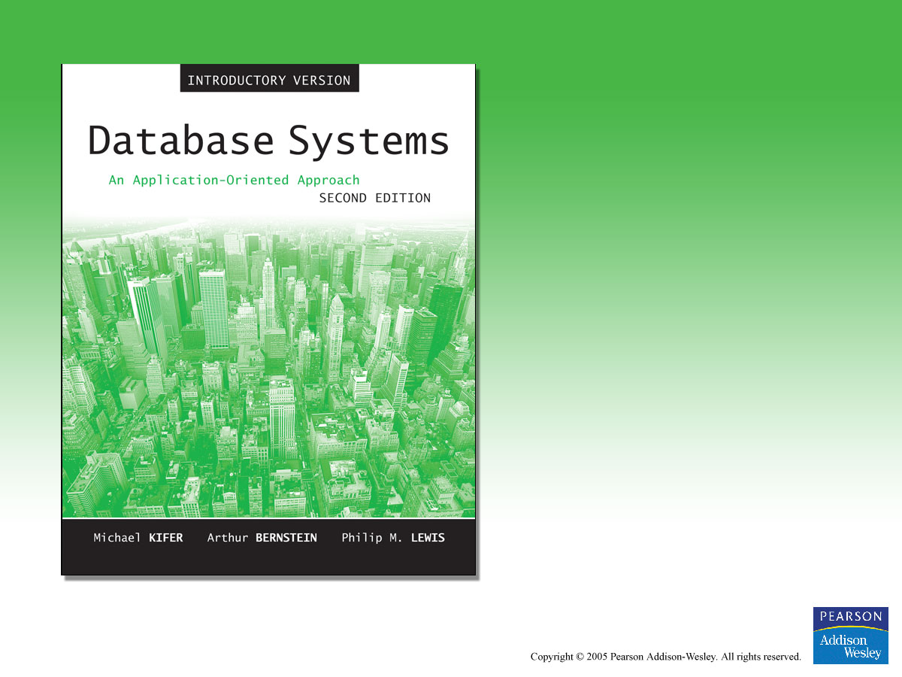
Chapter 5
Relational Algebra and SQL

Slide 2

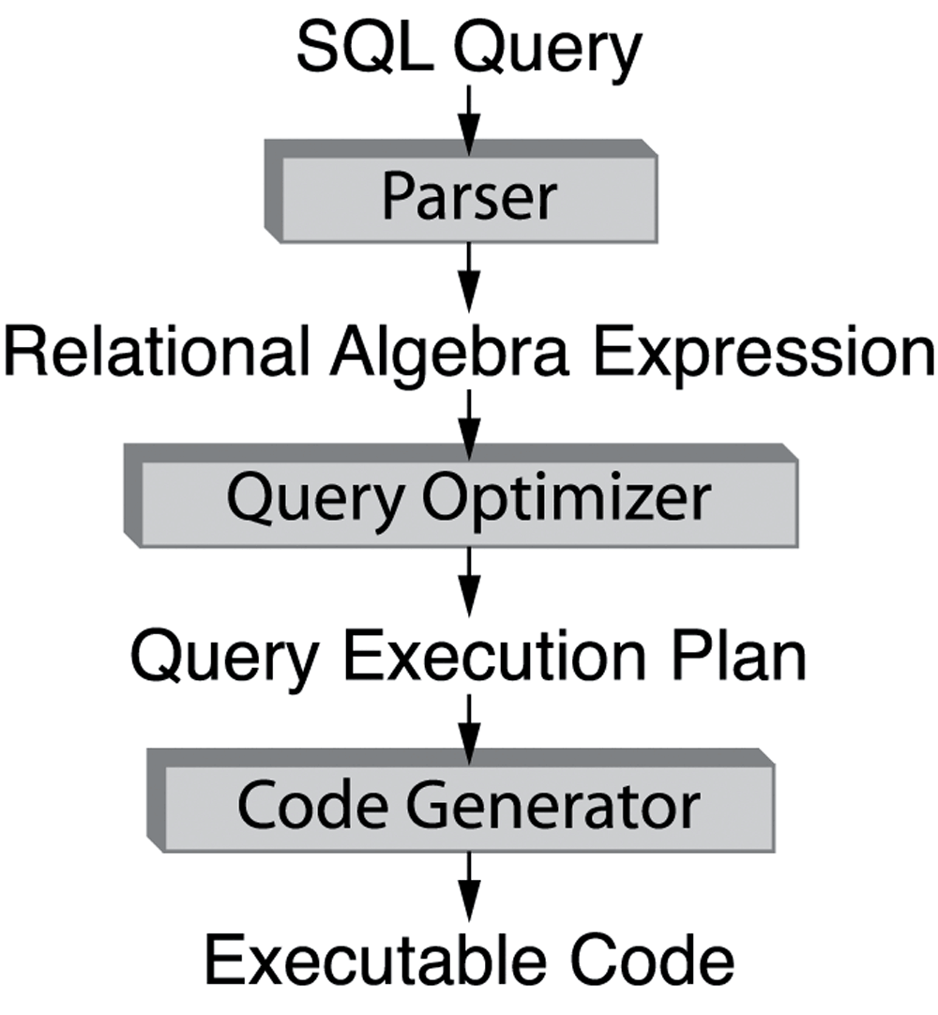
Figure 5.1 Schematic view of query processing.

Slide 3
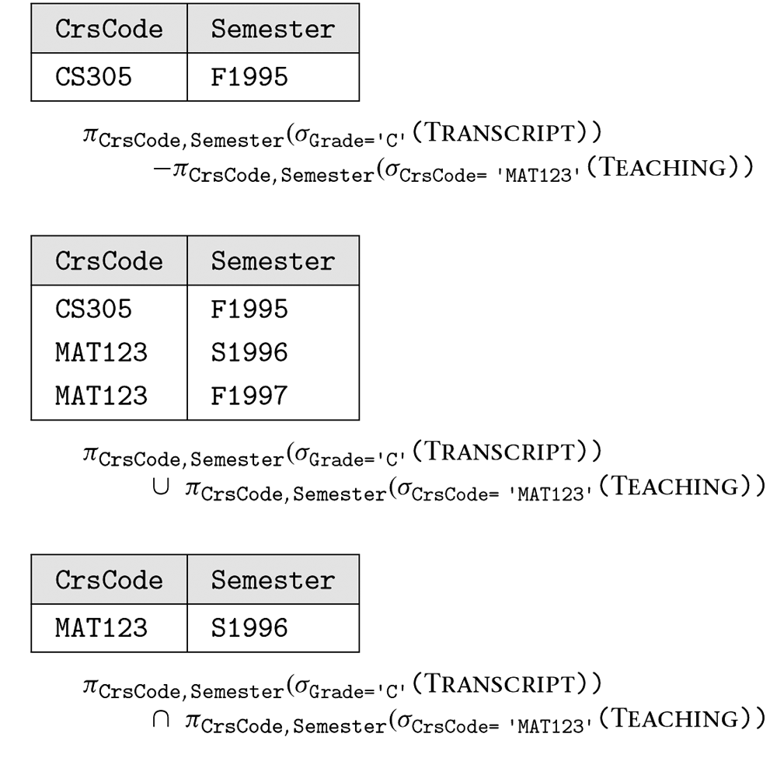
Figure 5.2 Examples of relational expressions that involve set operators.

Slide 4
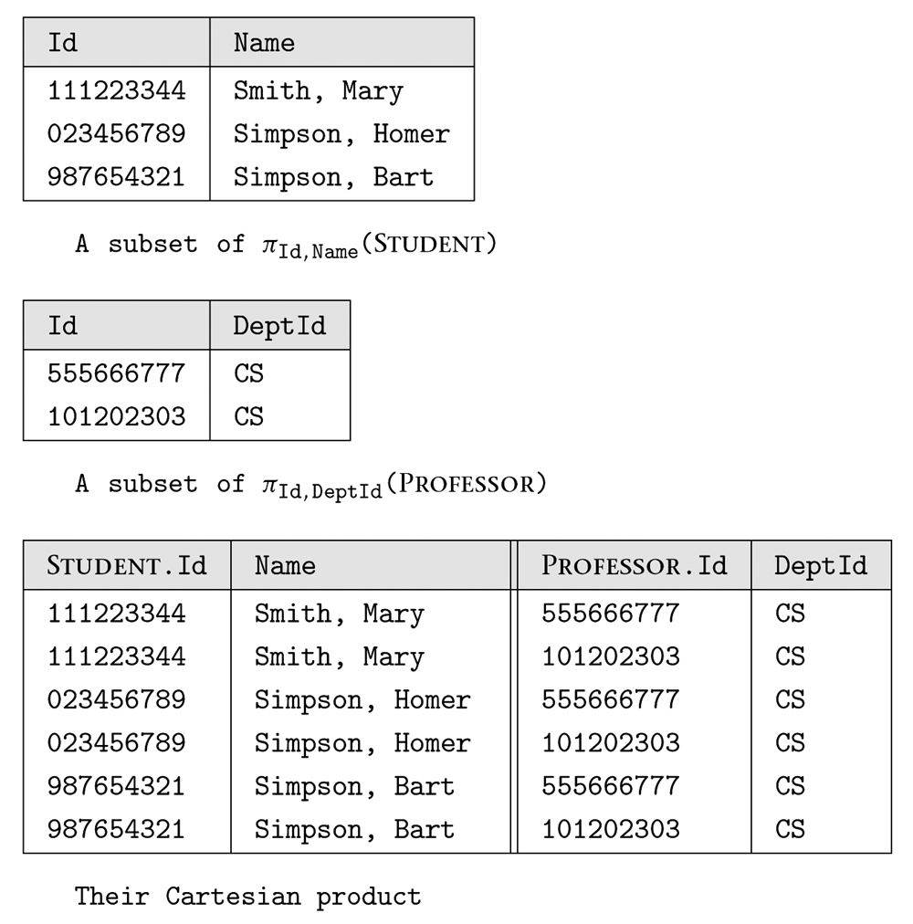
Figure 5.3 Two relations and their Cartesian product.

Slide 6
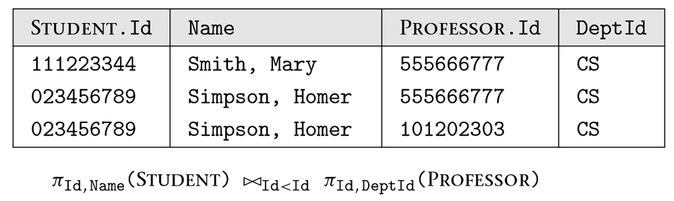
Figure 5.4 Join of relations in Figure 5.3.

Slide 7
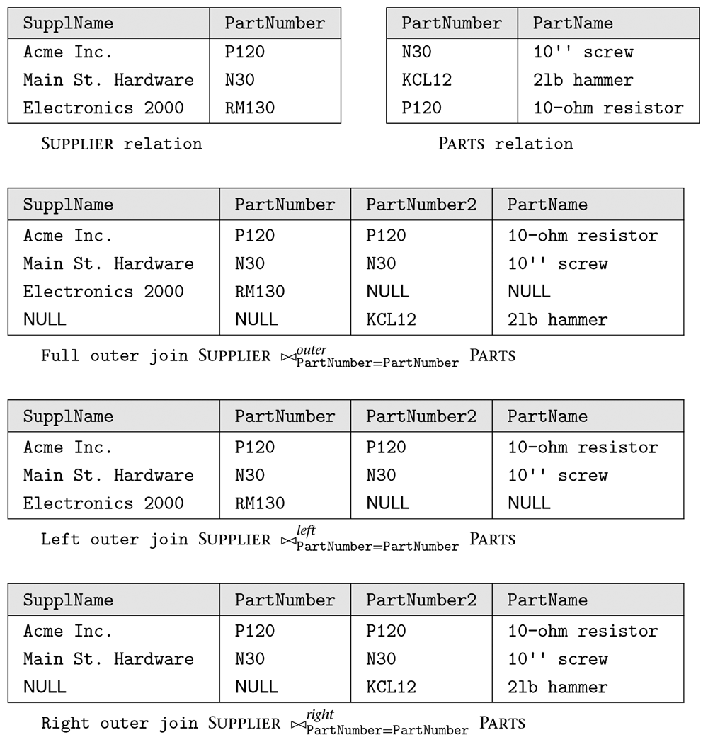
Figure 5.5 Outer joins.

Slide 8
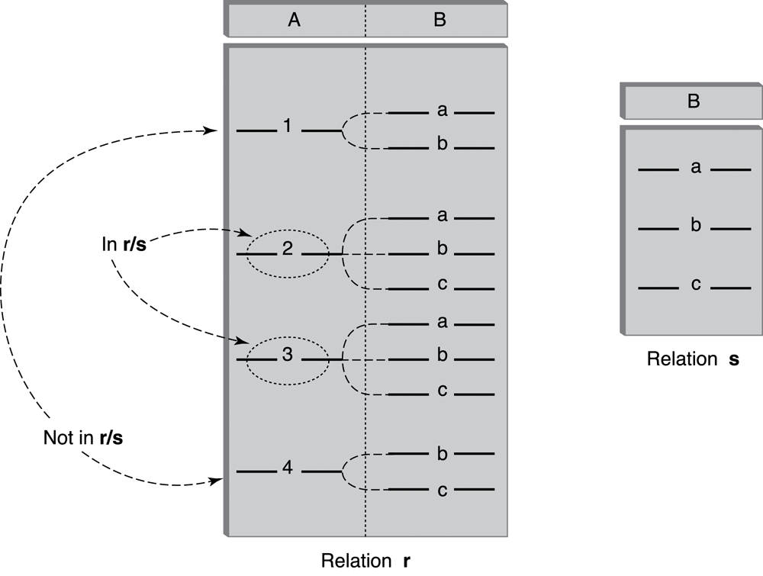
Figure 5.6 Division operator.

Slide 9
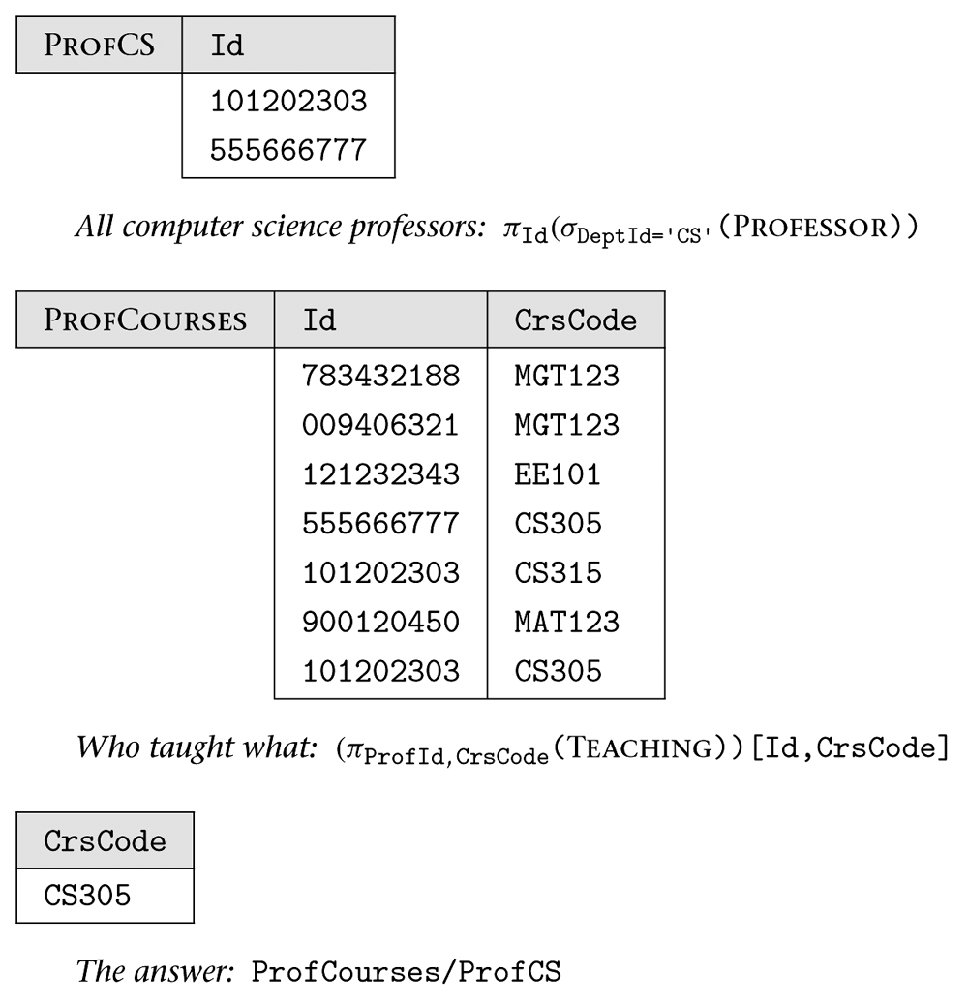
Figure 5.7
The anatomy of a query: Courses taught by every computer science professor.

Slide 10
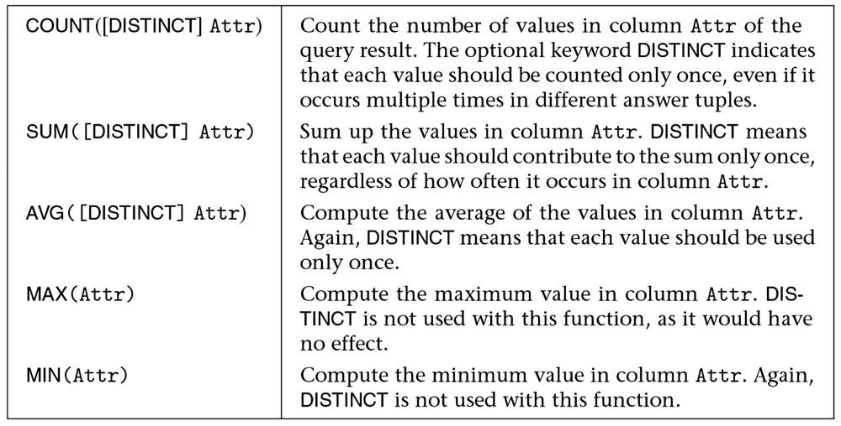
Figure 5.8 SQL aggregate functions.

Slide 11
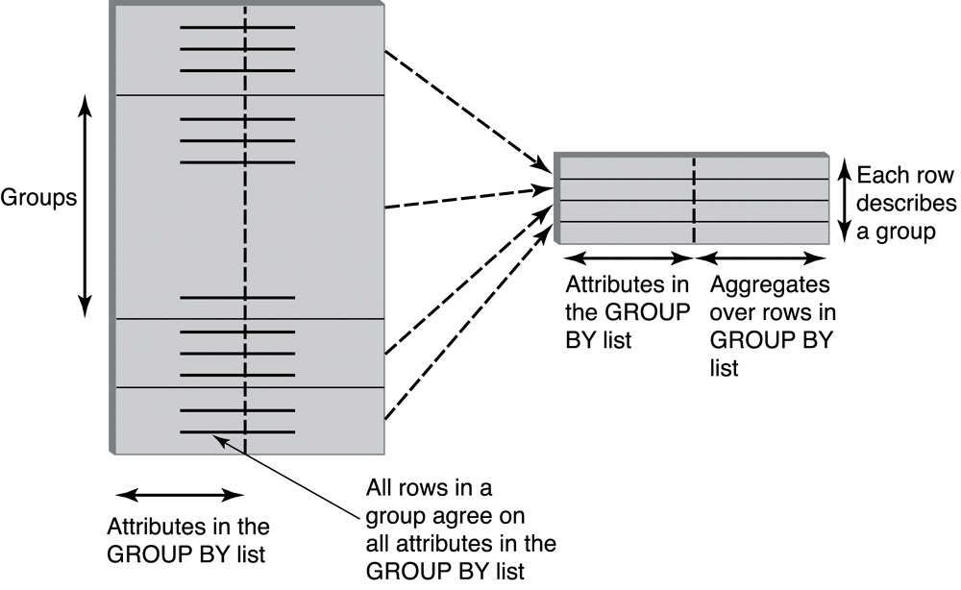
Figure 5.9 Effect of the GROUP BY clause.

Slide 12
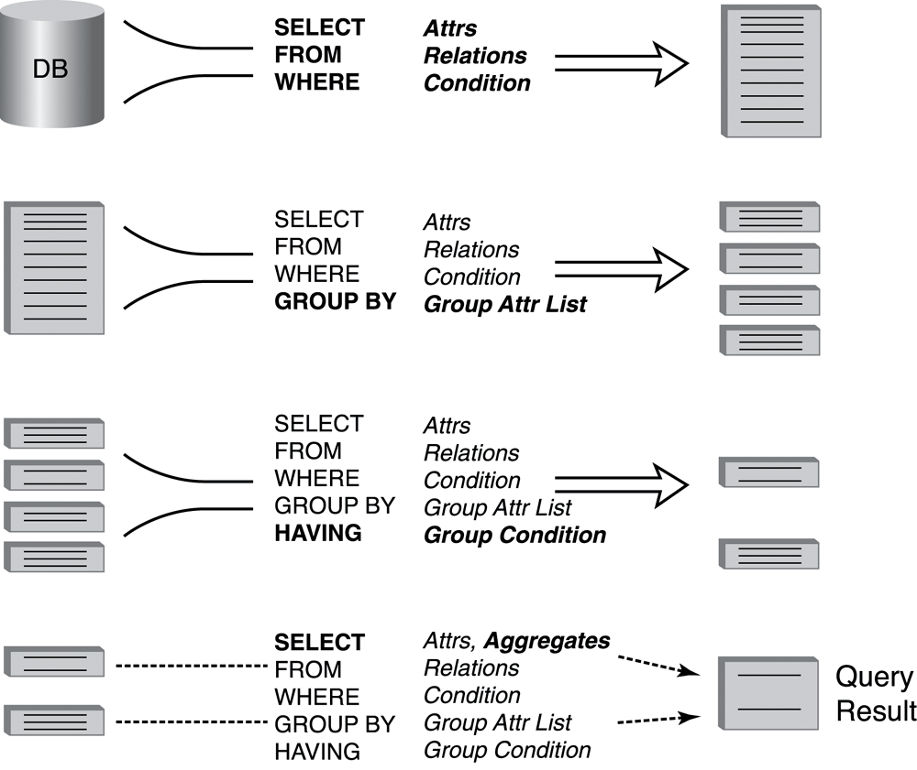
Figure 5.10 Query evaluation with aggregate functions.

Slide 13
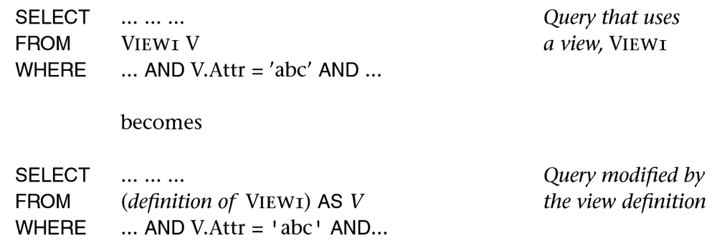
Figure 5.11 Process of query modification by views.

Slide 14
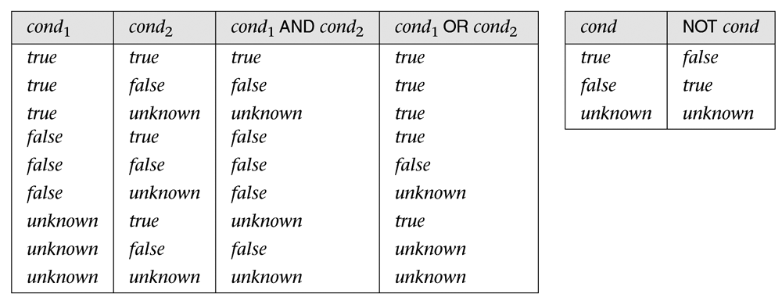
Figure 5.12 SQL’s truth tables used to deal with the unknown.

